Slide 1


Damson Furniture Redesign
By/
Wessam Mohammed Elsayed Alhanafy
Heba Ahmed Ibrahim Agamy
Menna Ahmed Ibrahim Agamy

Slide 2


What’s the project about?
This project involves a comprehensive UI/UX analysis and redesign of the Damson Furniture website, focusing on improving usability, accessibility, and overall user experience.
Project Goal
To redesign the Damson Furniture website by applying HCI principles, improving visual hierarchy, navigation, and creating a more intuitive and accessible shopping experience.
01

Slide 3
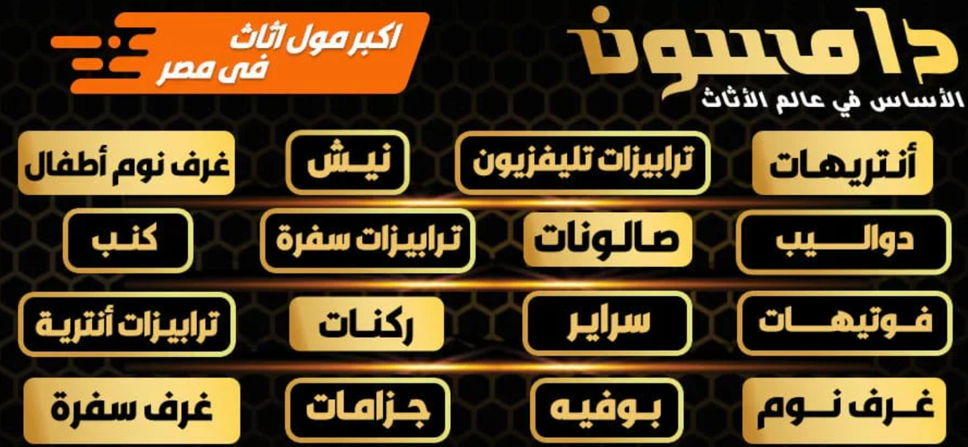
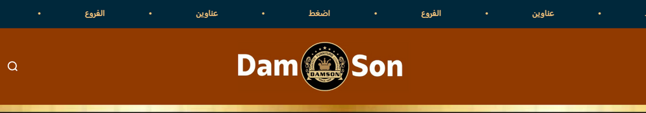

Old Design UX Problems
The first image displayed on the homepage creates the illusion of being clickable; however, it is merely a static image that does not lead the user anywhere.
The bar at the beginning of the homepage should have quick access to both branches and addresses, but in fact, the bar moves continuously which make it not easy for the user to access the branches quickly. Also, every word you click on in the bar redirects to branches, which leads to insufficient redundancy.
Certificates and information about the company are scattered throughout the homepage alongside the products, which may lead to confusion.
02

Slide 4
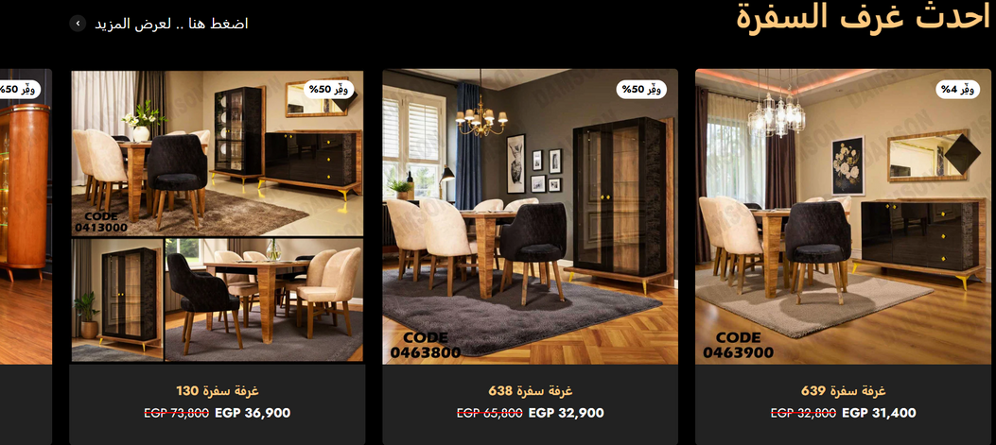
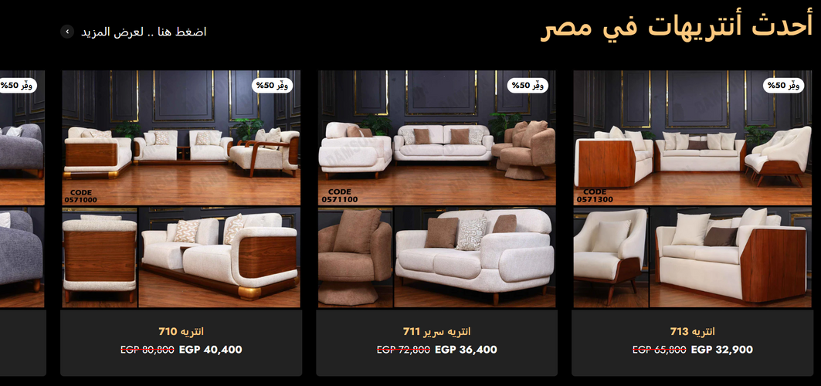
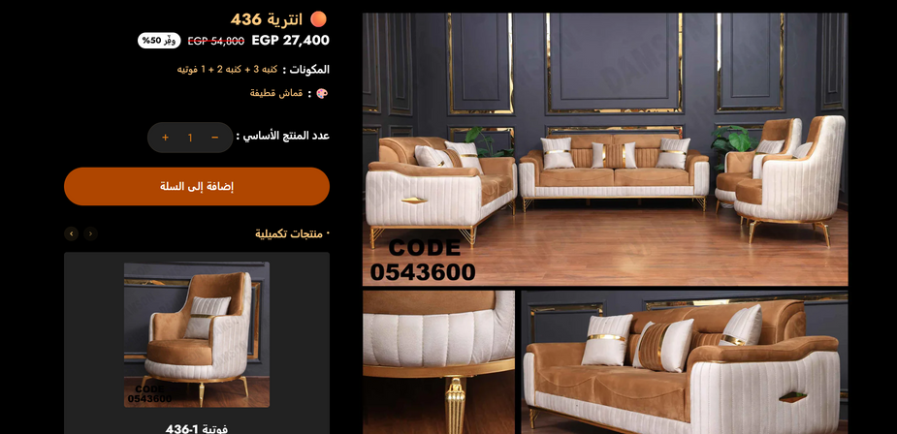
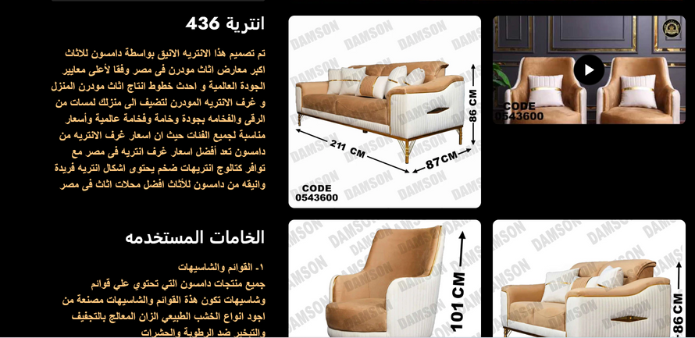
Old Design UX Problems
The homepage displays all product categories,
resulting in it being excessively long and making
it more difficult to locate the item you’re searching for. This affects the accessibility to pruducts.
When selecting a product to view, users must scroll down to see all the product images, which can be quite tiring. Additionally, the sidebar that holds product details moves down alongside you, requiring you to return to the top of the page to add the product to your cart or check its details. Furthermore, there is no section for product reviews available.
03

Slide 5
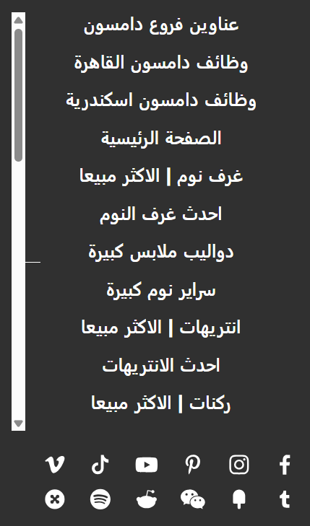
Old Design UX Problems
The sidebar features product categories and links redirecting to the homepage; however, the homepage is not the first option, which may confuse users.
Additionally, there is a link to job openings in branches, which may not be relevant to users.
Finally, some of the social media links in the sidebar do not connect to actual accounts for the Damson company.
04

Slide 6
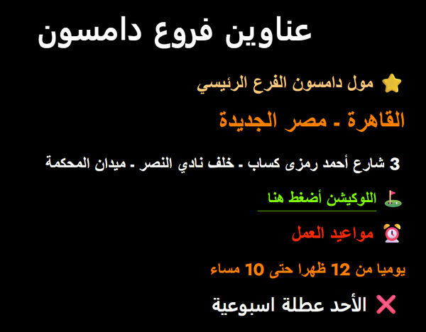
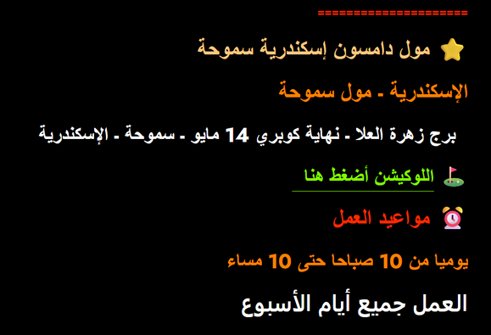
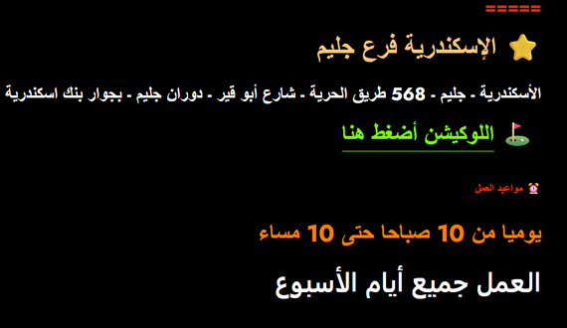
Old Design UX Problems
All the branches are listed one below the other without any spaces distinguishing one branch from the next, making it difficult to locate the branch you need.
The text color of the branches suggests that they are clickable, but in fact, only the location links redirect to Google Maps.
05

Slide 7
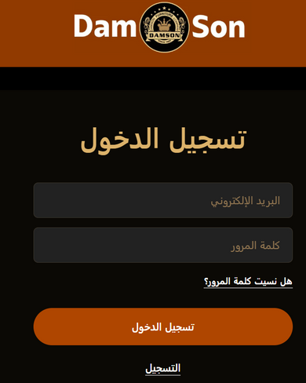
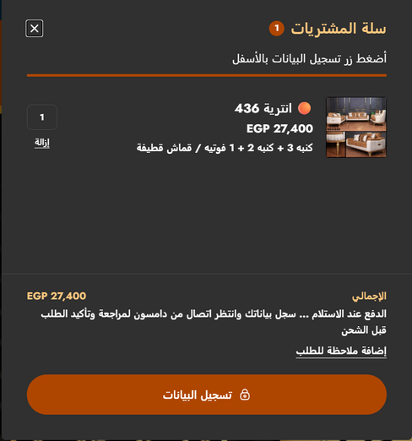
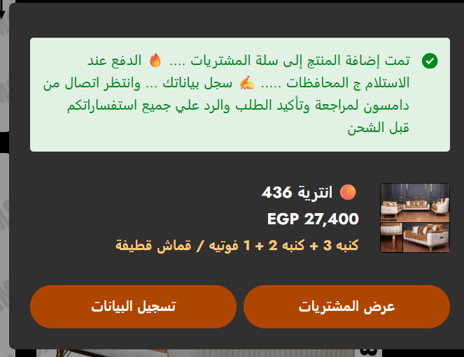

Old Design UI Problems
Inconsistent Colors: There are various font styles and sizes being used without a clear pattern. The color scheme lacks unity and fails to reflect the brand's identity.
Weak Contrast
A lack of sufficient contrast between text and backgrounds can make content difficult to read, particularly for users with visual problems.
Weak Visual Hierarchy
There is a lack of clear differentiation between primary and secondary elements. As a result, all content seems equally significant, which makes the user's ability to prioritize information difficult.
06

Slide 8
Redesign & Problems Solutions

Slide 9
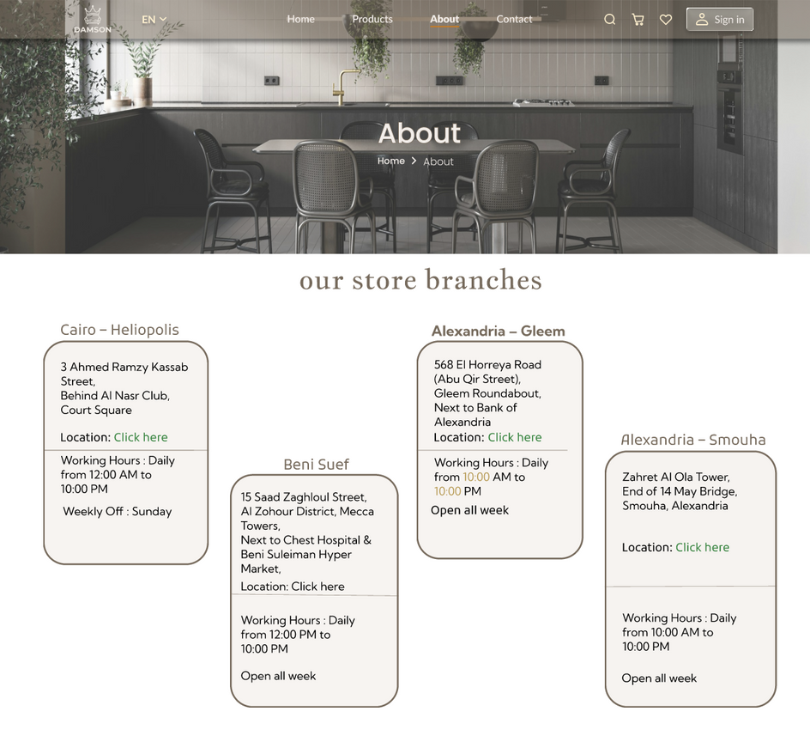
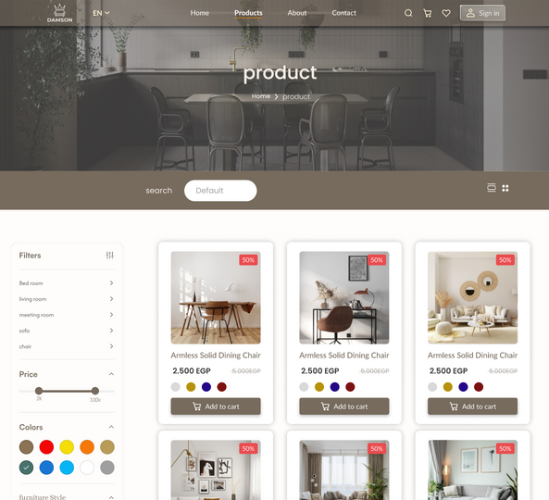
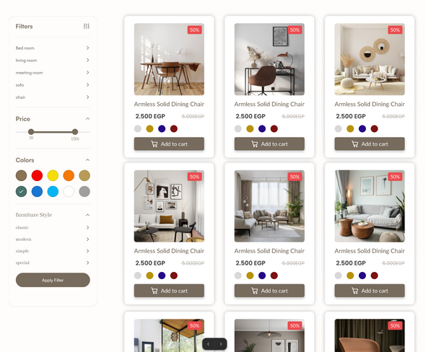
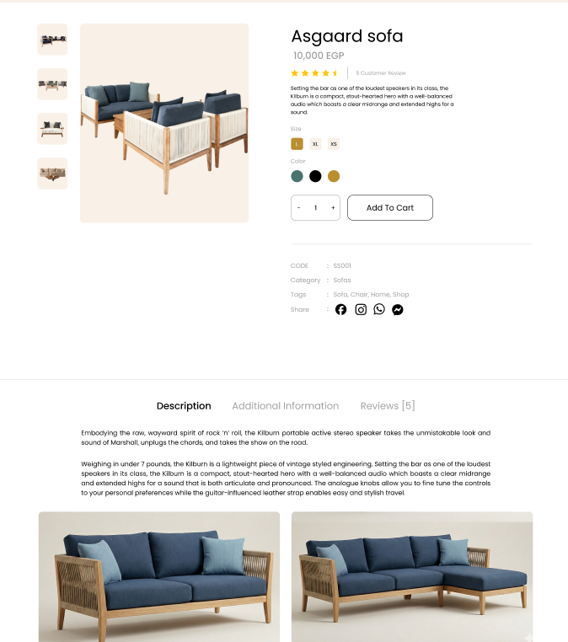

Redesign & Problems Solutions
2
We have developed an “About” page that provides access to the branches, detailing their locations and working hours. Additionally, it includes certificates and other relevant information.
UX Solutions
3
We redesigned the single product page for enhanced clarity, positioning the description below the product eliminating the problem of scrolling back and forth. Additionally, we introduced a reviews section and an additional information section for the product.
1
We developed a product page and organized the items into categories in a sidebar to simplify the search process and accessibility to products.
07

Slide 10
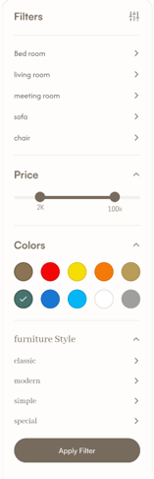

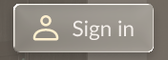
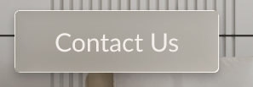
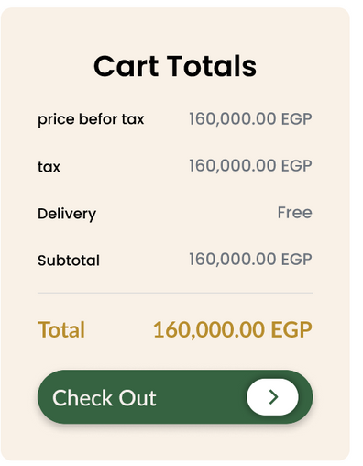

Redesign & Problems Solutions
UX Solutions
We made the sidebar focus on product categories and filters, and social media was added to the new website footer for easy accessibility.
We converted the previously non-clickable buttons into functional clickable ones that redirect to the desired pages. This includes the navigation bar and buttons for Cart, Sign In, Contact Us, Explore More, and Check Out.
08

Slide 11
Redesign & Problems Solutions
UX Solutions
We introduced a dedicated section for the branches in the “About” page, and redesigned it to enhance its visual appeal by using more attractive colors and placing each branch in a distinct box. This design makes it easier to navigate to each branch.
Above each box, you will find the name of the government corresponding to that branch. Inside each box, the working hours are provided along with the associated locations links.
The certificates have been relocated to the "About" page, alongside the "Why Choose Us" section.
09

Slide 12
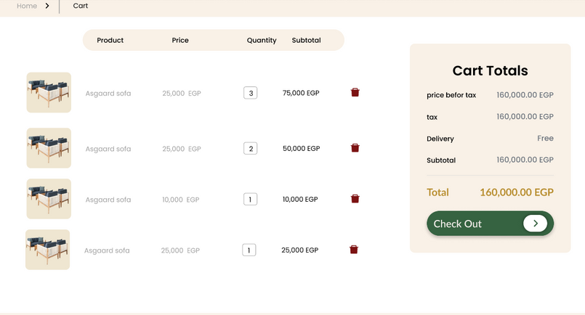
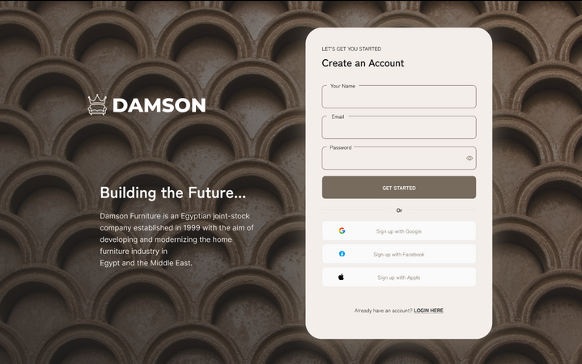
Redesign & Problems Solutions
UI Solutions
3
We enhanced the cart with a more streamlined, modern, and user-friendly design. Additionally, we created a receipt prototype that features a “Check Out” button redirecting users to the payment page.
1
We have redesigned the sign-in page with a more modern and visually appealing design.
2
We have streamlined the sidebar by making the categories more clear, and the colors more appealing.
10

Slide 13
Introduced New
UI Design

Slide 14

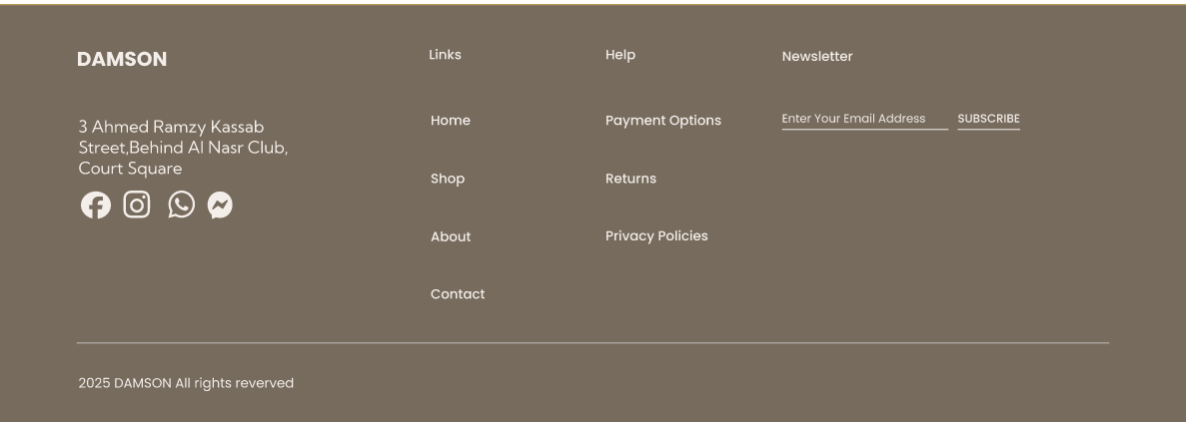

Introduced New UI Design
The new logo &
the old one
The new
footer menu
11

Slide 15

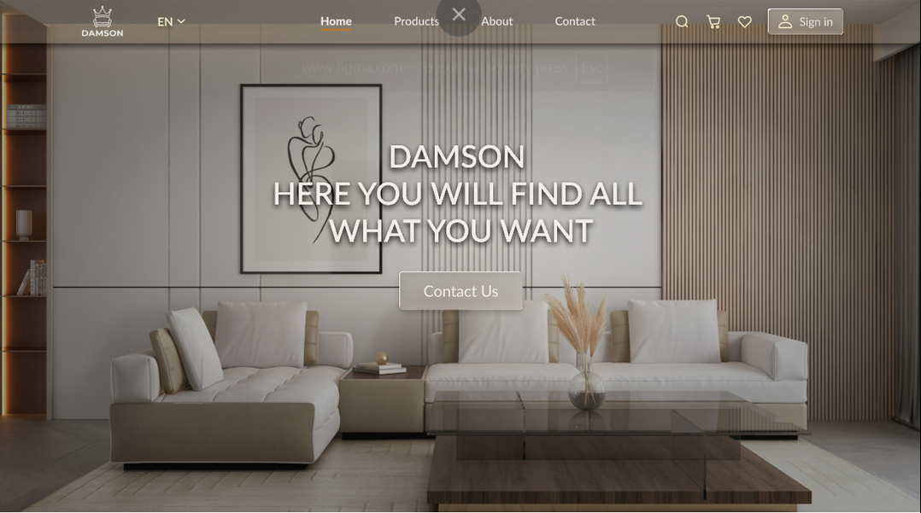
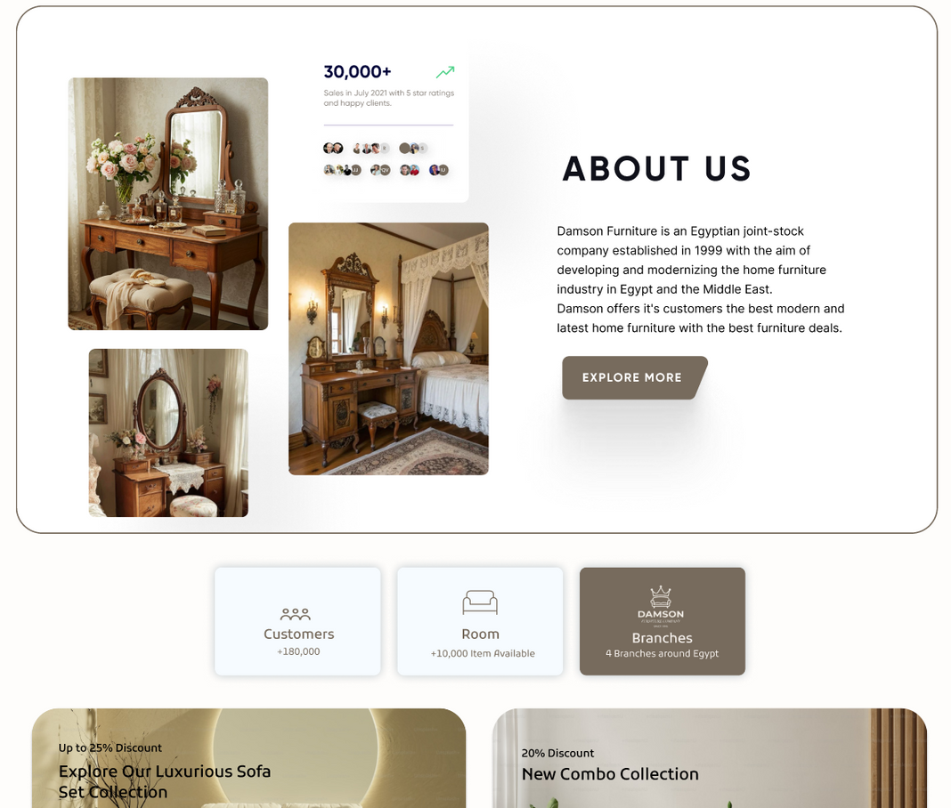
Updated Homepage
12

Slide 16
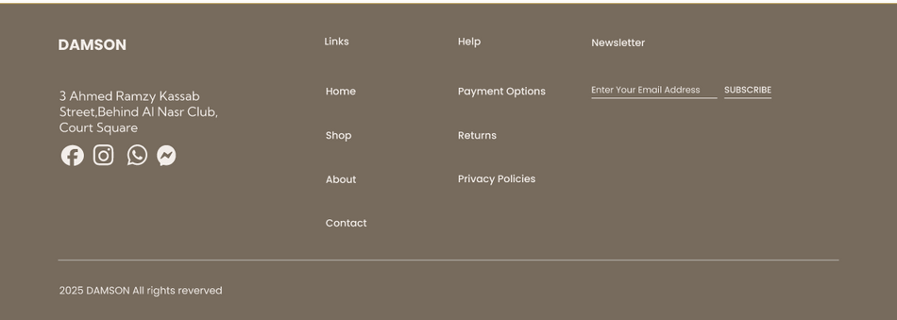
New Branches&
Certificates Page
13

Slide 17
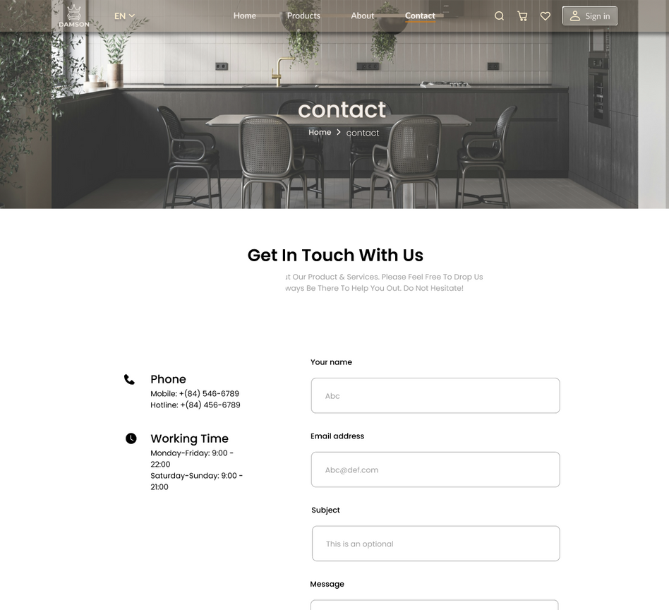

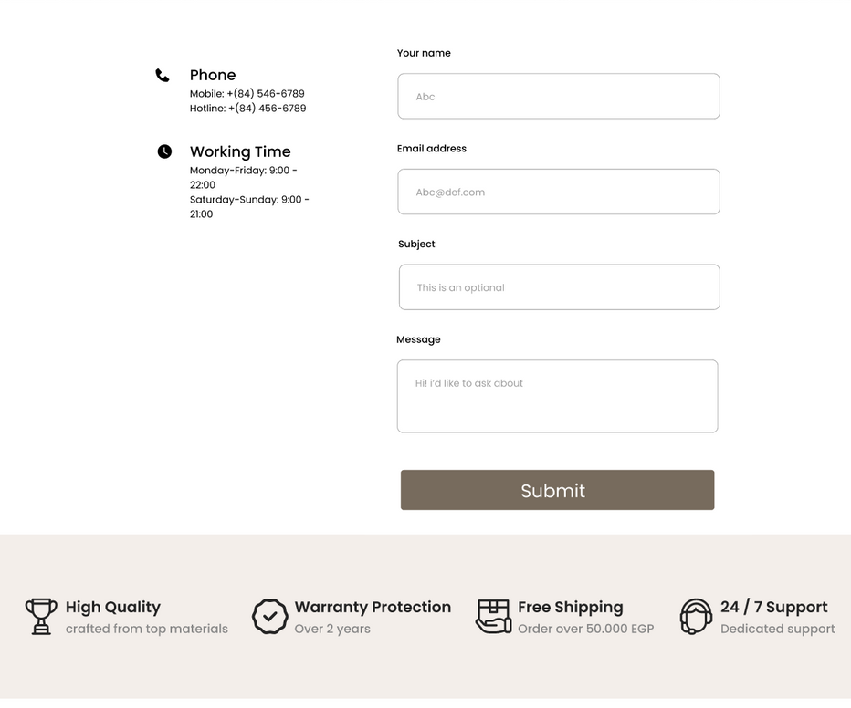
New Contact Page
14

Slide 18

Thank You!
FigmaPrototypeLink
Under Supervision
https://www.figma.com/proto/ISYLn5bW117aXdjMQsGMDj/damson-11111?node-id=2146-392&p=f&t=bxWAYZaf20Lci0qj-0&scaling=min-zoom&content-scaling=fixed&page-id=0%3A1&starting-point-node-id=1%3A2&hide-ui=1
Dr/ Osama Ghoneim
Eng/ Omar Khaled

